Slide 1

Presentation INF442
Hacking the Paris metro

Slide 2
Reflexion on the big data : Expected
Bus and metro schedules
Use it on real-time data
Can we predict the delay of a metro or a bus ?
Comment : same as before about the sanitary situation, and we don’t have data on the delay
Can the delay of the bus prevent road traffic ?
Comment : we don’t have any data about road traffic
Make a model trained on the past data
Comment : probably not working because of the lockdown

Slide 3
Reflexion on the big data : Reality
Impact of the covid on ratp traffic on several models :
Selection of data (frequency each hour)
Linear Regression in C++ : analytical
More sophisticated models with in python (with Scikit-learn library) : fitting with iterations

Slide 4
Preprocessing
Input : Frequencies of each line in 2018
Output : Expected frequencies of each line in 2021
Each frequency is computed per hour

Slide 5

C++

Slide 6

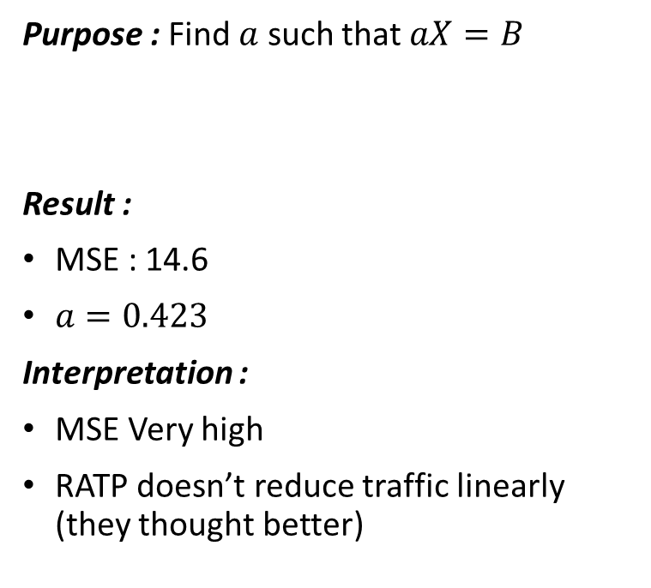
Linear Regression in C++
Purpose : Find $a$ such that $aX=B$
Result :
MSE : 14.6
$a=0.423$
Interpretation :
MSE Very high
RATP doesn’t reduce traffic linearly (they thought better)

Slide 7
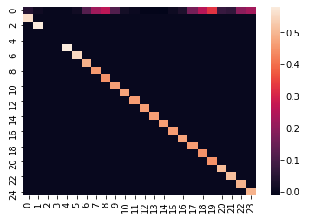

Linear Regression in C++
Purpose : Find $A$, a diagonal matrix, such that $AX=B$ with a bias
Result :
MSE : 0.33
Interpretation :
MSE is much smaller than before
Each line has an adaptative traffic

Slide 8
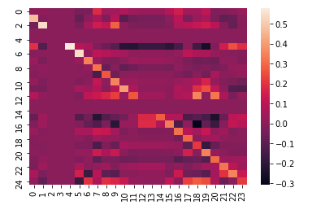

Linear Regression in C++
Purpose : Find $A$, nondescript matrix, such that $AX=B$
Result :
MSE : 0.13
Interpretation :
MSE so much smaller
Interdependance of each line

Slide 9

Python

Slide 10

Fitting Models in Python
Ridge regressor :
Find $\hat{A}$ such that :
$$\hat{A}=\underset{β∈ℝ^{d+1}}{argmin}{\frac{1}{n}}\sum_{i=1}^{n}{{\left(y_{i}−\left[1 x_{i}^{T}\right]A\right)}^{2}+α{\left\|A\right\|}_{2}^{2}}$$
MSE : 0.35 with $α=1$
Identify an overall trend by reducing the impact of peak times

Slide 11
Fitting Models in Python
Gradient Boosting regressor :
From an initial model, upgrade it iteratively by a greedy algorithm
MSE : 0.26
Upgraded Ridge, thus the interpretation is similar

Slide 12
To put it in a nutshell
Linear regression models are better than fitting models
Due to a lack of data
Correlation between the different ratp lines
We can predict the reduction of the traffic

